Slide 1
Contact Information (While you wait…)
Please send me and e-mail and I will add you to an
e-mail distribution group.
*Tell me about a special activity your child enjoys. Add a photo if you would like.
Diane.Broksieck@k12.sd.us
Sign the sign in sheet before you leave tonight

Slide 2
1st Grade Parent Informational Meeting
Mrs. Diane Broksieck
Classroom Phone: 696-4620
Email: Diane.Broksieck@k12.sd.us

Slide 3
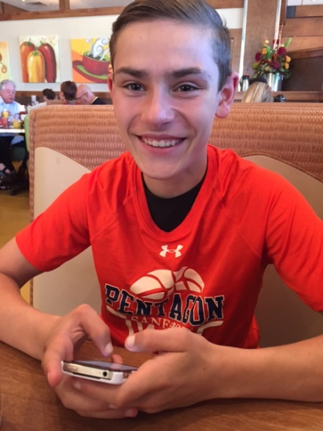
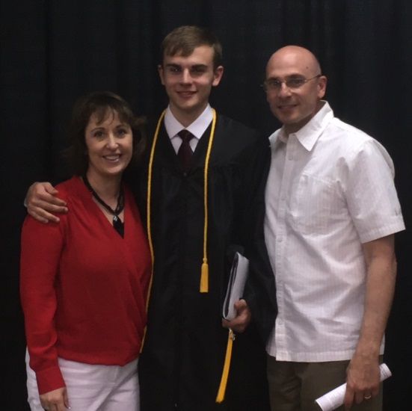
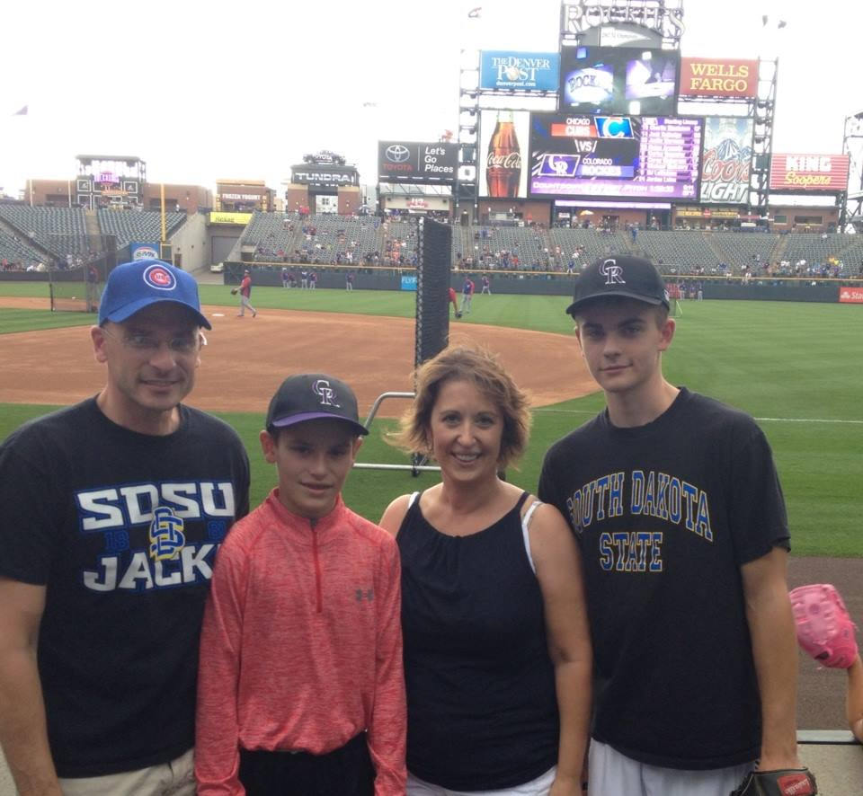
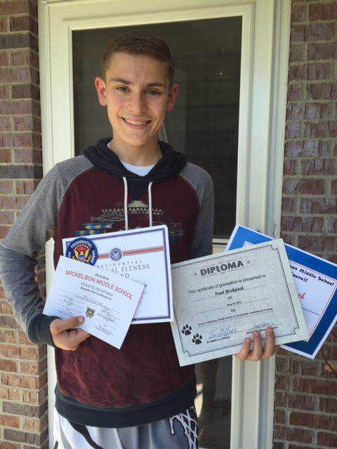
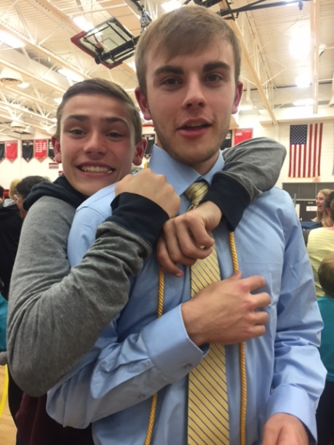
My Family…My Story

Slide 4
Take-Home Folder
Communication Back & Forth
Please check daily & return the following day
Notes/Money Pocket
Contacts & Schedule
Newsletter/Things to Do

Slide 5
Literacy
Shared Reading (poetry, big books, basal stories)
Reader’s Workshop /Daily 5
~Guided Reading
~Reading Bags
*Back and Forth Every Night, Begin sometime in September, Book
Exchange Available Weekly(Monday) may supplement with personal books or library books
Writer’s Workshop
~Personal Narratives, Non-Fiction, Opinion, Fiction, Friendly Letter

Slide 6
Literacy (Cont.)
Reading Recovery and Title I
RTI Screening (Response To Intervention)
Benchmark screening Fall, Winter, Spring
RTI/Title Groups
Spelling
Begin after conferences
Blend of Word Patterns and High Frequency Words
Oral Language
Rules of Speaking and Listening
Handwriting
Davis Learning Clay Letters
ELA Common Core State Standards
http://doe.sd.gov/octe/commoncoreStandards.aspx

Slide 7
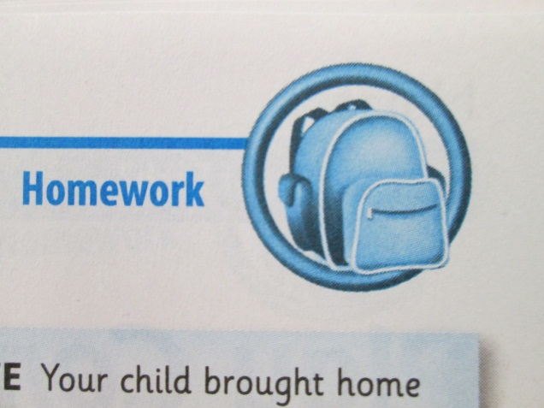
Math
Investigations
~Homework/Extra Workbook Pages
*Review of concepts
*Every Friday in Game Binder
*Return by following Friday
~Home Letters, Salmon colored
~Inquiry Based (Discussion is VERY important)
Math Common Core State Standards
Practice Standards
http://doe.sd.gov/octe/commoncoreStandards.aspx

Slide 8
Social Studies/Health/Science
Usually focus on ONE of these areas at a time
The same grade will be reflected in both areas on the report card.
The grade is based on effort, participation, and completion of work
Past Topics include: Ladybugs, Hatching Chicks (lifecycles), Oceans, Deserts (Habitats), Living/Non-Living, Animal Groups, Voting, Rules (Citizenship), Friendship, Maps/Atlas
New State Standards

Slide 9
Classroom Management
Be A Bucket Filler
3 Basic Rules
~Respect
~Responsibility
~Caring
Class Dojo Growth Mindset https://www.youtube.com/watch?v=Rzzb5cmNoc0&feature=youtu.be
~Positive/Negative Behaviors Points
~Monthly Celebrations/Dojo Money/Tickets
~I-pad travels to Encore
~Parents can sign up
~Using Dojo effectively (low expectations vs perfection)
Positive Attitude Perseverance Goal Setting
Growth Mindset https://www.youtube.com/watch?v=Rzzb5cmNoc0&feature=youtu.be

Slide 10
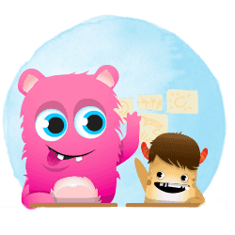
Dojo Point Goals
Simple
Examples Include:
Bringing a stuffed animal to class for the day
Choose your own Avatar (First 10 Points)
Wear slippers for the day
Lunch in the classroom
No homework pass (Write on “Free Homework” on paper)
Note home to parents
Work at the teacher’s desk
Bring something special from home to show to the class
Trip to the treasure box

Slide 11
Healthy Snacks
Our district would like to encourage healthy/snacks treats.
Birthday treats are acceptable but not required
We would kindly request that if your child has peanut products for breakfast that they wash their hands before coming to school.
Send a snack to school
Individual
Healthy NO Cookies, Candy
Snack after morning recess

Slide 12
Odds & Ends
Book Orders
Birthdays (We Celebrate ½ Birthdays)
E-mail List
Friendship List
Volunteers
PTA
Parking
Sign-up Genius
Hillcrest Website: http://www.brookings.k12.sd.us/Domain/13

